Slide 1
CREDIT CARD FRAUD DETECTION USING MECHINE LEARNING
AND AN EXAMPLE MODEL IN PYTHON

Slide 2
INTRODUCTION:
Credit card fraud detection is vital for financial security.
OBJECTIVE:
Demonstrate fraud detection using machine learning in Python.

Slide 3
LIBRARY USED:
NumPy
Pandas
Scikit-Learn

Slide 4
EXAMPLE CODE FOR LOAD AND IMPORTING LIBRARIES:
import numpy as np
import pandas as pd
from sklearn.model_selection
import train_test_split

Slide 5
PROCESSING AND MODEL BUILDING
# Load the credit card transaction dataset (replace 'creditcard.csv' with your dataset)
data = pd.read_csv('creditcard.csv’)
# Split the dataset into features (X) and the target variable (y)
X = data.drop('Class', axis=1)
y = data['Class']# Split data into training and testing setsX_train, X_test, y_train, y_test = train_test_split(X, y, test_size=0.2, random_state=42)

Slide 6
STANDARDIZATION AND MODEL TRAINING
# Standardize the features
scaler = StandardScaler()
X_train = scaler.fit_transform(X_train)X_test = scaler.transform(X_test)
# Train a logistic regression modelmodel = LogisticRegression()model.fit(X_train, y_train)

Slide 7
MODEL EVALUATION
# Make predictions on the test sety_pred = model.predict(X_test)
# Evaluate the model
accuracy = accuracy_score(y_test, y_pred)
precision = precision_score(y_test, y_pred)
recall = recall_score(y_test, y_pred)
f1 = f1_score(y_test, y_pred)

Slide 8
DISPLAY EVALUATION METRICS
# Print the evaluation metrics
print(f'Accuracy: {accuracy:.2f}’)
print(f'Precision: {precision:.2f}’)
print(f'Recall: {recall:.2f}’)
print(f'F1 Score: {f1:.2f}')

Slide 9
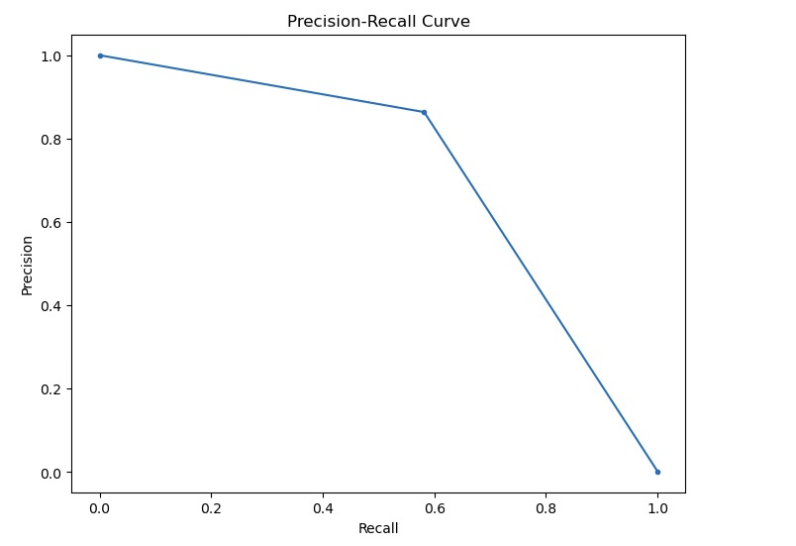
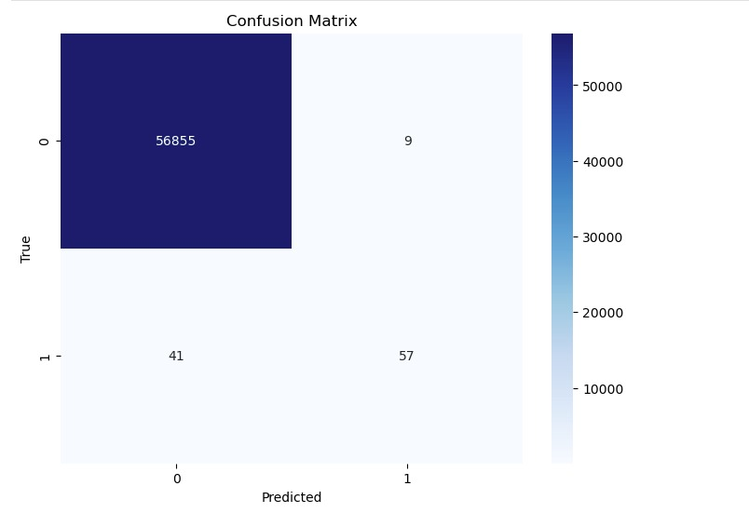
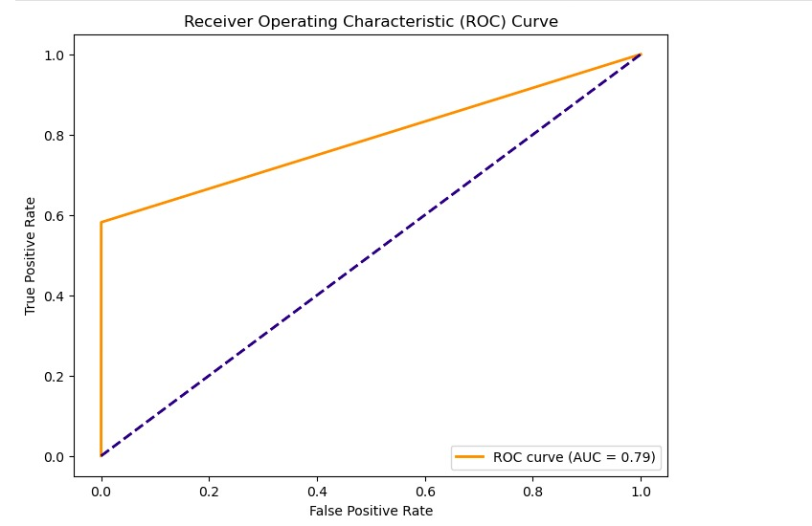
OUTPUTS:

Slide 10
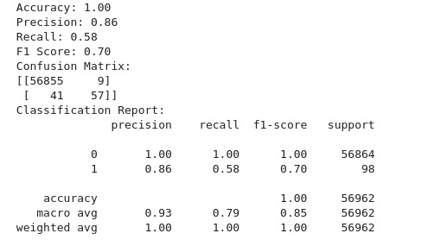
MODEL OUTPUT:

Slide 11
CONCLUSION
Emphasize the need for more advanced techniques in real-world fraud detection. You can use the content above as a starting point and customize it to create your PowerPoint presentation. Add visuals, design elements, and additional slides as needed to make the presentation more informative and visually appealing.

